Slide 1
Harder, Better, Faster, Stronger
Semi-Auto Vulnerability Research
Notes:
Industrialization
Not fuzzer
Not Tools
Ford care analogy
Unique snowflake / pile of bugs on a thumb drive
Every bug a BMW ☺ mass produced, worth 40k, makes someone very happy

Slide 2
Professional Vulnerability Research
Finding bugs is not the problem
Fuzzing works
Microsoft found over 1800 bugs in Office 2010
http://blogs.technet.com/b/office2010/archive/2010/05/11/how-the-sdl-helped-improve-security-in-office-2010.aspx
280 bugs found in Mozilla JavaScript using JSFunFuzz
https://bugzilla.mozilla.org/show_bug.cgi?id=jsfunfuzz
Tooling is not the problem
Distributed fuzzing
Crash analyzers
Lack of intelligent workflow is the problem
Notes:
Have to explain the difference between dumb and smart fuzzing here. These are smart fuzzers, they took a long time to make and a long time to run. What if there was a way to get your cake and eat it too, applying “workflow” to dumb fuzzing can improve its odds.

Slide 3
Main Goal
Develop an effective workflow and toolset for fuzzing and triaging vulnerabilities in a production environment
Notes:
Production Environment – not software dev – want to sell bugs, or keep munitions depot full.
Exploits (bugs) are the commodity we sell
Based on exploit ninja team size, keep them busy all the time with bugs that don’t take “too long” to exploit.
“Maintain a consistent flow of reliably exploitable vulnerabilities”
I think we should break this down a bit. The tools we’re supplying do not help you write reliable exploits yet.

Slide 4
Ancillary Goals
Primary
Determine cause and exploitability
Human time efficiency
Secondary
CPU efficiency
Ease of use
Notes:
Exploit output: I can keep sploit writers busy easily by giving them very difficult to exploit bugs over and over – not good; we want to have them be busy, also have a good output
CPU time: not nearly so important, throw hardware at it – still, we don’t want to redo work! Don’t do unnecessary work!

Slide 5
Process Breakdown
Attack Surface Analysis
Input Selection
Fuzzing
Triage
Notes:
Triage needn’t be tied to fuzzing effort! Main idea of the day: separate triage from your fuzzing effort.
Break up fuzzing into test generation, and test execution

Slide 6
Keys to Fuzzing Smartly
Input selection
Most important factor in timely bug discovery
Time management
Automation
SIMPLE Distributed fuzzing
Crash analysis
Bucketing
Confidence Rating
Notes:
KEYS TO THE FIRST THREE STEPS IN THE PREVIOUS SLIDE: Fuzzing isn’t something you do actively. You want to kick it off and forget it. Should be SIMPLE to add systems/programs/inputs/tests

Slide 7
Keys to Smart Bug Triage
Crash selection
Select for understanding
Crash database
Bug classes
Program flow analysis
Code coverage
Input Mapping
Taint Analysis
Notes:
Triage and fuzzing are totally disjoint. Key to time management is crash selection. What is relevant to your interests.
KNOW WHAT TO TRIAGE QUICKLY

Slide 8
Input Selection
Attack Surface Analysis
Determine which areas of the code are reachable from external inputs
Template code coverage
Determine what areas of code are exercised by different templates
Rank templates based upon coverage of targeted code or overall attack surface
Notes:
Ancillary goals: human time, cpu time, ease of use

Slide 9
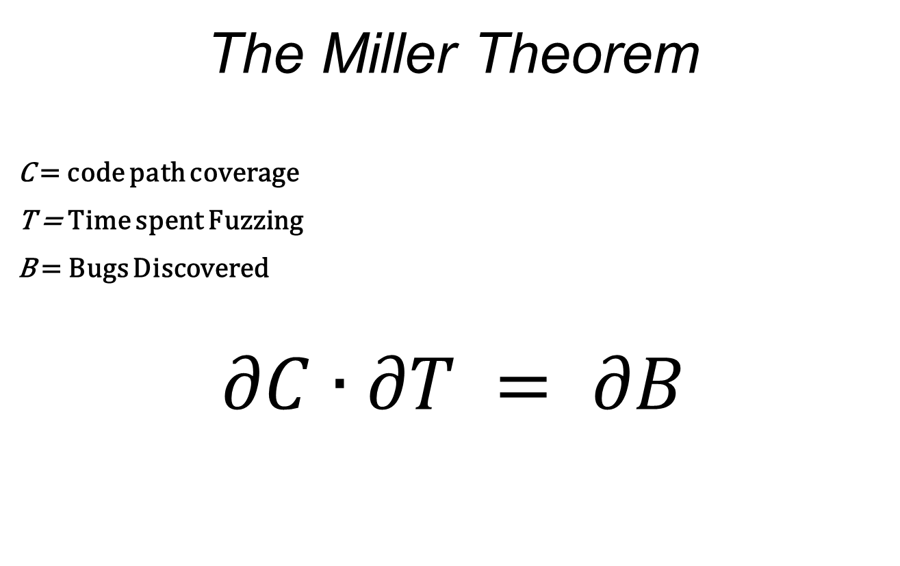
Fuzzing
The Miller Theorem
C = code path coverage
T = Time spent Fuzzing
B = Bugs Discovered
$$∂C∙∂T = ∂B$$
Notes:
More time? More bugs. More code path coverage? More bugs.

Slide 10
Fuzzing
Obey the Miller Theorem
Create inputs to maximize coverage
Create the framework to maximize uptime
Generation vs. Mutation
If you can, do both!
Mutation is cheaper, still works
Do as little work as possible
Re-do as little work as possible
Notes:
How to obey: set up input selection to maximize code coverage, create framework to make it easy to maintain uptime, add resources
Talk about generation time sink, lots of people time, unfocused cpu time; mutation is fast / cheap – don’t need to find ALL the bugs
Ancillary goal: people time efficiency – mutation as long as it works – no reason not to mutate!

Slide 11
Fuzzing
Test Execution
Data Collection
Retesting
Notes:
People see fuzzing as a single thing. Ongoing process. “I fuzzed X” makes no sense. Reeval, find new attack surface, refuzz! Automate that! Bindiff, store diff graphs, they become your new attack surface.

Slide 12
Fuzzing – Test Execution
Watch your tests well
Embedded custom debugger
Be able to gather needed data at crash time
Make use of debugging technologies
Be able to avoid invalid exceptions
Distribute your tests
Centralized management
Make it easy to add nodes
Notes:
Don’t redo work you’ve already done (running tests) - running in a debugger doesn’t slow down a test.
Ignore / catch handled issues, use debugging technologies (pageheap)
Tests are atomic. Distribute. Make it easy. Enlist your sales force desktops.

Slide 13
Fuzzing – Data Storage
Use a database!
Store lots of data over time
Easily searched
What to store
Store what you need for crash selection
All crash information
Software versioning information
Binary diffs
Notes:
Fuzzing is ongoing. Storage is cheap. Store your data forever.
You’ll have to pull crashes for triage some day – store everything that will help you to decide what to triage, when – store everything that isn’t costly
Store coverage graphs for base files, attack surface graphs, etc

Slide 14
Fuzzing - Retesting
Maintaining a good database allows:
Automated retesting of modified code paths
Automated retesting of crashes in modified code paths
Track bug life across software versions
A bug which lives through a nearby patch can have a long shelf-life
MS08-067 and MS06-040
ANI
Notes:
Just store your base file and it’s code path coverage graph. Auto-pull inputs that will test changed paths. Kickoff retests when a new diff is imported.

Slide 15
Triage – Crash Selection
Which crashes should receive priority?
What properties make crashes more exploitable?
Knowledge! Familiarity!
Crash database
Vulnerability properties
Searchable crash criteria
Notes:
Leaving crash creation. Two groups. One who does just triage / possibly exploitation. Mine database for bugs you understand. Dowd, NPD in actionscript. What if you threw them all out? Need a crash with certain properties. Check the database.

Slide 16
Triage – Crash Selection
Exception Analysis
Determine level of access exception grants user
Bug Class Identification
Difficulty of exploitability varies by bug class
Custom architecture problems
Custom memory allocators

Slide 17
Triage – Program Flow Analysis
Abstract a program into flows
Code execution
Data dependency
Code Coverage
Block hit trace for path to exception
Build a graph of program execution
Augment static program graphs

Slide 18
Triage – Program Flow Analysis
Input Mapping
Trace APIs or System Calls that perform I/O
Mark data copied from external sources into memory
Taint analysis
Follow input through the execution of the program
Determine where the bytes of the crash originated
Potential for exploit and signature generation

Slide 19
Triage – Program Flow Analysis
Visualization
Provides a graphical representation of program structure and execution paths
Visualization allows overlaying multiple graphs and datasets using visual cues
Converting data to a visual problem allows rapid understanding of large datasets

Slide 20
Moflow

Slide 21
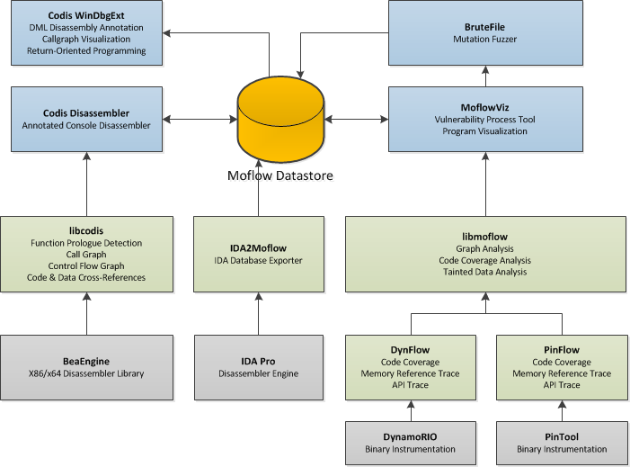
Notes:
Ancillary goals: human time, cpu time, ease of use

Slide 22
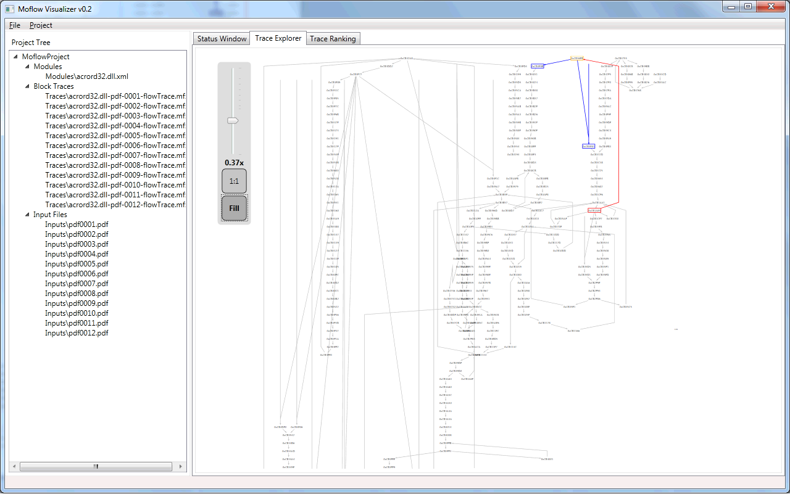
[Moflow.png]
Notes:
Ancillary goals: human time, cpu time, ease of use

Slide 23
Moflow: Input Selection

Slide 24
Input Selection - Requirements
Attack Surface Analysis
Call graph analysis
Template code coverage
Dynamic tracing
Template ranking
Coverage graph analysis
Notes:
Do not explain these yet, upcoming slides

Slide 25
Attack Surface Analysis
Obtain call graph
IDA2Moflow.idc
LibCodis
Define APIs that are data entry points
 | Input Source | I/O API
File | NtOpenFile() NtCreateFile() SYS_Open() | NtReadFile() NtWriteFile() SYS_Read() SYS_Write()
Network | connect() accept() | send() recv()

Slide 26
Attack Surface Analysis
Determine reachability graph from each API
δ-wavefront ← RootSet
closure ← 〈〉
While nonEmpty(δ-wavefront) Do
wavefront ← oneStep(δ-wavefront)
δ-wavefront ← wavefront − closure
closure ← closure ∪ δ-wavefront
End While
Return closure
δ-wavefront Algorithm – Qadah et al.
Notes:
The δ-wavefront algorithm’s theoretical time complexity is linear in the number of edges in the graph
Builds a worklist of items 1 node away from current set, each node not in previously analyzed set is added to worklist

Slide 27
Template Code Coverage
Dynamic Tracing
Instrument each basic block in a program
Efficiently record execution order of all blocks
Implementation - PinFlow
Program tracer written as a PinTool
Hook on block cache creation
Inject instructions into cached code blocks
Callback function writes binary struct to ringbuffer
Ringbuffer flushed when full and on program exit

Slide 28
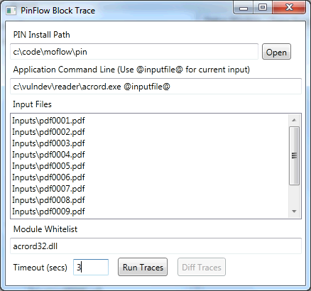
Template Code Coverage
Moflow Visualizer PinFlow Trace Launcher

Slide 29
Template Code Coverage
Advantage – Speed
PIN is much faster than traditional breakpoint or trap based solutions
11.57 times faster!
7zip Benchmark Test
Block Tracer | Time (sec)
Process Stalker | 20.48
PinFlow | 1.77

Slide 30
Template Prioritization
Select functions for attack surface
Calculate reachability to create attack surface graph
Rank stored traces by number of nodes hit in attack surface graph
Notes:
Explain, screenshot next

Slide 31
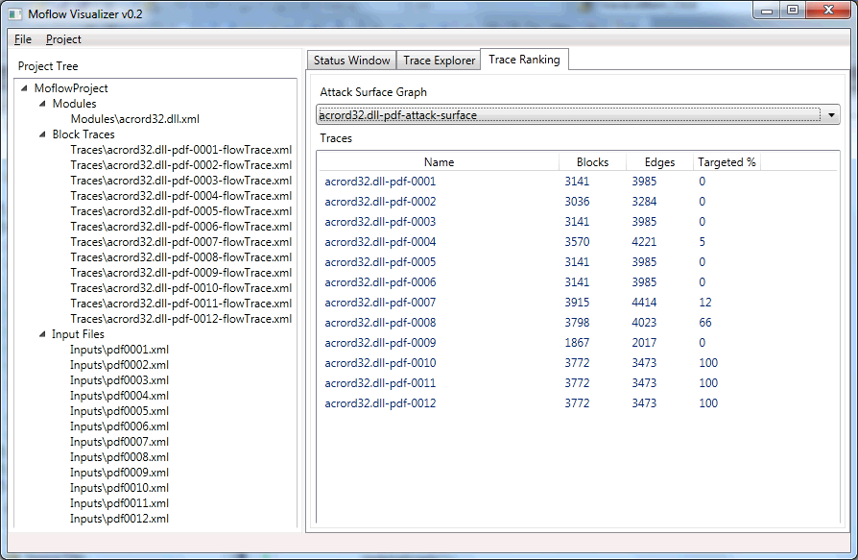
Template Prioritization
[TraceRank.png]

Slide 32
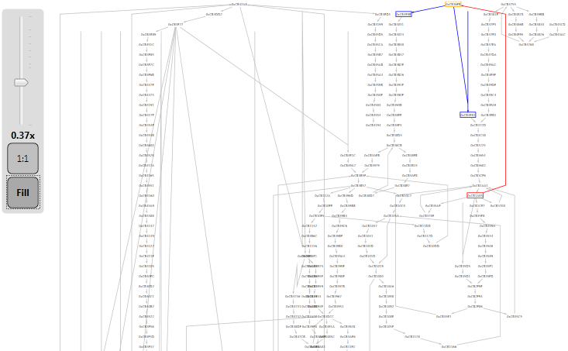
Graph Visualization
Moflow Block Trace Graph Visualization
[Graph 1]

Slide 33
Fuzzing Automation

Slide 34
Fuzzing Automation
Distributed Fuzzing
Fuzzer Management
Data Gathering
Crash Mining
Notes:
Create a process framework around your fuzzers. Make the fuzzer interchangeable.

Slide 35
Distributed Fuzzing
Tests are small and atomic
Distribute simply
Make it easy to add systems
Easy to add tests
Centralized Management
Aids in speedy addition of hardware
Notes:
Obviously want to distribute. Necessitates centralized management. Store scripts, binaries, input generation data, etc. For generation, maybe you just pass created inputs out for testing

Slide 36
Fuzzer Management
Customizable yet simple
Ignore first chance exceptions?
Add debugging technologies?
Max test case timeout
Ease of use is key
Quick recovery for dead hosts
Quick addition of new hosts
Centralized management w/ database
Notes:
Manage your test cases. Don’t just collect crash dumps. Otherwise, you’re redoing work. Not conducive to continuous fuzzing. No stages in continuous fuzzing until we get to triage, after selection. Asynchronous!

Slide 37
Fuzzer Management
Jobs are held in the central DB
Job details passed to workers
Test cases are generated by workers as needed
Successful crashes are returned to the DB with details
Test cases are wrapped with a custom debugger
Data is returned to the central DB

Slide 38
Basic Worker
Job Collection (curl -> sql database)
Fuzzing Engine (anything you like!)
CPU Monitor (WBEM)
Debugged Test Thread (dbgext)
Data Collection (Codis, dbgext)
Data Reporting
(curl -> sql database)
Notes:
Get scripts, base files, configs, etc; Use whatever mutator / generator you’d like; Run the test case, monitored; collect data, report data;

Slide 39
Data Gathering
Store what you must
Bucketing
Categorization
Indicators of Exploitability
Store what you have
Why redo work?
Can’t know what you may need
Store it smart
Database!
Notes:
Things we need for selection; bucketing data, some categorization, enough data to eyeball a crash – changes over time
Things we get for free; might as well store it because what we need to eyeball a bug may be different in 6 months
Store it somewhere we can SEARCH.

Slide 40
Crash Mining
Post-crash analysis is performed on crashes deemed “relevant”
Relevant crashes are those which are:
Familiar to your exploit developers
Relate to your attacking goals
Relevant crashes are mined as needed from the database with queries.
What is relevant changes over time.
Notes:
Decide what to triage as it becomes interesting. Mark crashes as checked on a certain date. Narrow your searches. Find the low hanging fruit.
Very cool to exploit bugs people don’t yet understand. But they are “Bad ROI Bugs”

Slide 41
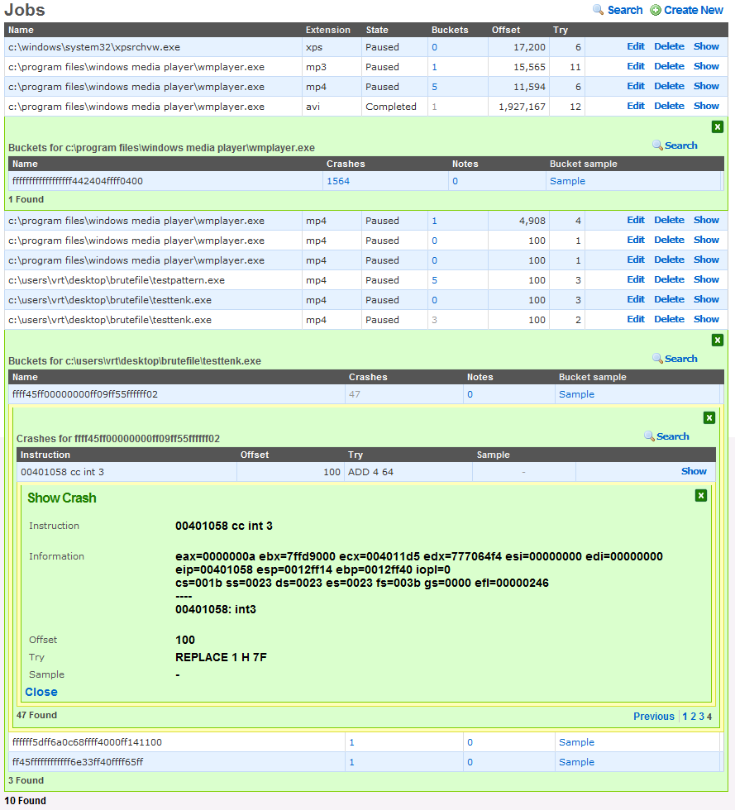
Notes:
Herbert interface – web interface to the centralized database

Slide 42
Moflow: Triage

Slide 43
Triage - Requirements
Exploitability
Exception information
Deep Trace
Triggering Condition
Fuzzer feedback
Taint analysis
Root Cause
Graph analysis

Slide 44
Triage - Exploitability
Exception Information
Brutefile outputs XML data containing exception information
Deep Trace
Code Coverage
Attack surface APIs
Dataflow

Slide 45
Triage - Exploitability
Dataflow
Once exception is found program is traced using PinFlow to gather instruction level instrumentation
Blocks are hooked during cache and disassembled to instrument instructions that access memory
Dataflow callback function records the address and value of each memory read or write
Taint Analysis
Provides exception analysis functions with information about controlled bytes
Knowledge of controlled bytes allows more precise analysis

Slide 46
Triage – Triggering Condition
Fuzzer Feedback
As part of exception analysis data Brutefile includes information about mutation
Taint analysis
When triaging a bug from input with unknown modifications, perform taint analysis
Forward taint propagation from memory allocated to stored data from input file will reveal which bytes are referenced in the exception

Slide 47
Triage – Root Cause
Graph Analysis
Overlay graphs of several deep traces to determine similarity
If execution trace leading up to the crash is identical but different bytes were manipulated, root cause should be determined
Taint analysis
Follow tainted data in the exception back to the code location that first influenced the memory location with external data

Slide 48
Moflow: Tools

Slide 49
Console Disassembler
Console interface for libcodis
Static Analysis
Instruction Disassembly
Function Detection
Code and Data Cross-References
Function Control Flow Graph
Call Graph
Import IDA2Moflow and .map files

Slide 50
Windbg Integration
CodisExt
Windbg extension using the engextcpp API
Utilizes libcodis to extract disassembly graphs and cross-references
Utilizes Windbg DML functionality to allow a hyperlinked interface for cross references

Slide 51
Windbg Integration
0:000> !codis
[codis] Usage:
[codis] !codis load <moduleName> Load a module into the disassembler engine
[codis] !codis xrefs [functionAddr] Show caller/callees
[codis] !codis callers <functionAddr> Show function callers
[codis] !codis callees <functionAddr> Show function callees
[codis] !codis names Show names in codis database
[codis] !codis dis <moduleName> [functionAddr] Dump disassembly of a module or function
[codis] !codis dot Dump a GraphViz DOT file
0:000> !codis load test
[codis] Loading C:\Vulndev\test.exe
;------------------------------------------------------------------------------
; File Header
;------------------------------------------------------------------------------
; Binary format: 32-bit PE
; Byte Ordering: Little Endian
; Entry Point: 0000130b
; File Size: 112128 bytes
;-----------------------------------------------------------------------------

Slide 52
Windbg Integration
0:000> !codis xrefs
[codis] Function: 00401005 sub_00401005
[codis] xrefs to: 00401149
[codis] xrefs from:
[codis] Function: 0040100a sub_0040100a
[codis] xrefs to: 0040100f
[codis] xrefs from:
--- SNIP ---
[codis] Function: 00411850 sub_00411850
[codis] xrefs to: 00411763
[codis] xrefs from:
[codis] Function: 00411a58 wrapper_RtlUnwind
[codis] xrefs to: 0040e530 00407732
[codis] xrefs from:
[codis] Function: 44cbe836 sub_44cbe836
[codis] xrefs to: 0040e53
0:000> !codis dot
digraph G {
"00401005"
"0040100a"
"0040100f"
"004010c0"
"0040113a"
--- SNIP ---
"00401076" -> "0040100a"
"00401058" -> "0040113a"
"0040104b" -> "004010c0"
"0040100f" -> "00401070"
"0040100a" -> "00401030"
}

Slide 53
Windbg Integration
0:000> !codis dis test 00402eea
00402eea |
........ | ;;;;;;;;;;;;;;;;;;;;;;;;;;;
........ | ;;; S U B R O U T I N E ;;;
........ | ;;;;;;;;;;;;;;;;;;;;;;;;;;;
........ | sub_00402eea: ; xrefs: 0x00402f68 0x00402f31 0x004015f7
........ | 6a 08 | push byte 0x8 ;
00402eec | 68 60 a2 41 00 | push dword 0x41a260 ;
00402ef1 | e8 32 fd ff ff | call <sub_00402c28> ;
00402ef6 | e8 2e f9 ff ff | call <sub_00402829> ;
00402efb | 8b 40 78 | mov [eax+0x78], eax ;
00402efe | 85 c0 | test eax, eax ;
00402f00 | 74 16 | jz 0x402f18 ;
00402f02 | 83 65 fc 00 | and dword 0x0, [ebp-0x4] ;
00402f06 | ff d0 | call eax ;
00402f08 | eb 07 | jmp 0x402f11 ;
00402f0a | 33 c0 | xor eax, eax ;
00402f0c | 40 | inc eax ;
00402f0d | c3 | ret ;
00402f0e | 8b 65 e8 | mov [ebp-0x18], esp ;
00402f11 |
........ | loc_00402f11: ; xrefs: 0x00402f08
........ | c7 45 fc fe ff ff ff | mov dword 0xfffffffe, [ebp-0x4] ;
00402f18 |
........ | loc_00402f18: ; xrefs: 0x00402f00
........ | e8 46 48 00 00 | call <sub_00407763> ;

Slide 54
IDA Integration
IDA2Moflow.idc
Dumps static program call graph
Module
Functions
Calls
Works on all versions of IDA
Useful to overcome current limitations in static analysis provided by libcodis

Slide 55
Questions?

Slide 56
Email: rjohnson@sourcefire.com richinseattle@gmail.com
Twitter: Richinseattle
Email: lgrenier@sourcefire.com pusscat@metasploit.com
Twitter: Pusscat
Special Thanks to Chris McBee!

Slide 57
Extra Slides

Slide 58
Template Code Coverage
Dynamic Tracing
Implementation
Program tracer written as a PinTool
Designed for Win32 platform
Function and Block hooking for Code Coverage
System call hooking for I/O*
Memory reference trace*
Logging to standardized format

Slide 59
Static Analysis
Instruction Disassembly
Function Detection
Code and Data Cross-References
Function Control Flow Graph
Module / Program Call Graph

Slide 60
Instruction Decoding
BeaEngine 4
Multi-Architecture
x86 / x64
High performance
[stats]
Actively developed
[stats]

Slide 61
Function Detection
Prologue Detection
[Image of prologues]
Static call targets
[show dynamic call vs static call]

Slide 62
Code and Data Cross-References
Disassembly of functions results in extraction of CALLs, JMPs, and static data references
[image goes here]

Slide 63
Function Control Flow Graph
Break a function into basic blocks
JMP
CALL
RET

Slide 64
Module / Program Graph
Enumerate function cross references
Support loading multiple modules for inter-modular call graph

Slide 65
Dynamic Analysis
LibMoflow
High level program analysis library in C#
Code Coverage Analysis
Trace Differencing
Graph Analysis
Tainted Data Analysis

Slide 66
Code Coverage Analysis
Augment graph from static analysis with code coverage
Trace Differencing
CrashViz
Program Graph
Trace Overlays

Slide 67
Trace Differencing
Describe algorithm here

Slide 68
Graph Analysis
Loop Detection
Dominator Trees
etc

Slide 69
File Visualization
Hex and Strucutred Tree Views
Visualize Fuzzer File Mutations and other session metadata
Structure Decoding
Office Formats (GUT)
PDF (Only’s lib?)
FLASH (Patrick/Shong’s lib)

